Slide 1
Digital marketing
BY POOJA RANGANATHAN
BATCH: 7229

Slide 2
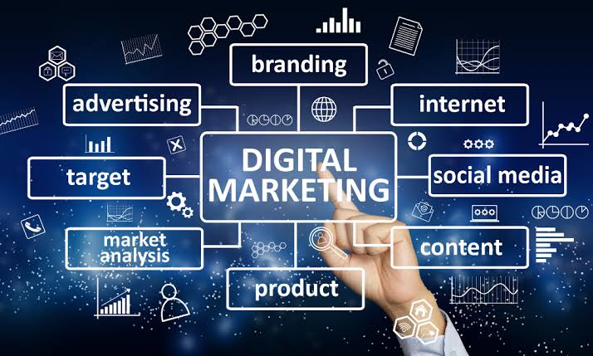
Digital Marketing is a booming industry in India as well as across the globe.
Almost all businesses are going online in their marketing activities to survive in the market for a long term
Its development during the 1990s and 2000s changed the way brands and businesses use technology for marketing

Slide 3
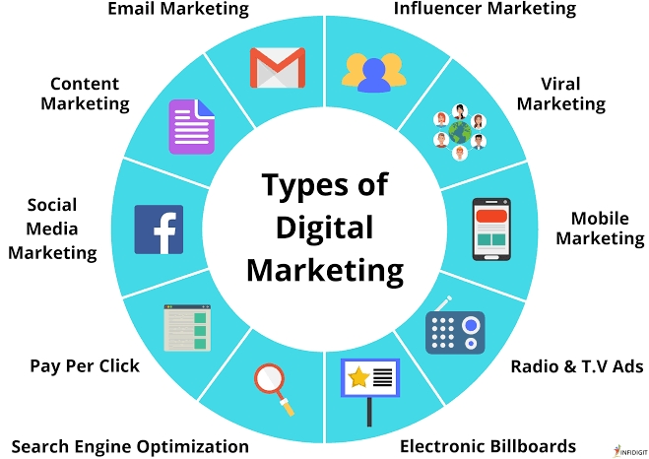
Types of digital marketing
Content marketing
Social media marketing
Email marketing
Affiliate marketing
Search Engine Optimization
Influencer marketing
Mobile marketing
Pay-per-click
etc….

Slide 4

Benefits:
Global Reach
Local Reach
Lower Cost
Easy to Learn
Effective Targeting
Multiple Strategies
Multiple Content Types
Increased Engagement

Slide 5
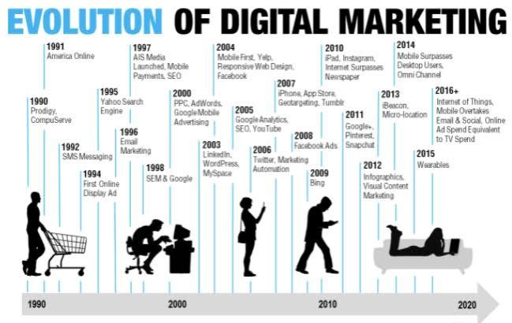
Evaluation of digital marketing:

